Slide 1
Fundamental of Compiler Design

Slide 2
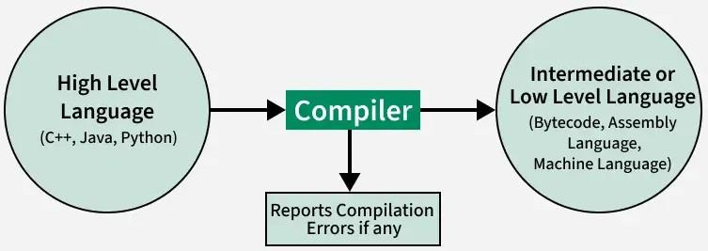
A compiler is software that translates or converts a program written in a high-level language (Source Language) into a low-level language (Machine Language or Assembly Language). Compiler design is the process of developing a compiler

Slide 3
Operations of Compiler
These are some operations that are done by the compiler.
Breaks source programs into smaller parts.
Enables the creation of symbol tables and intermediate representations.
Helps in Error Detection.
Saves all codes and variables.
Analyses the full program and translates it.
Convert source code to machine code.

Slide 4
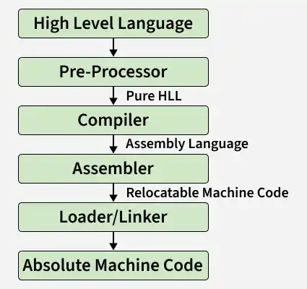

Slide 5
Preprocessor
Processes the source code before compilation begins.
It performs the following tasks:
File inclusion (#include)
Macro expansion (#define)
Removal of comments
Conditional compilation
Example:
If the program contains #include <stdio.h>, the preprocessor replaces this directive with the actual contents of the stdio.h file in the output.

Slide 6
Assembler
Assembly language is neither pure binary nor a high-level language. It is a low-level language that uses symbolic instructions to represent machine code.
The assembler converts assembly language into machine code.
It is platform-dependent (different systems require different assemblers).
The output produced is called an object file.

Slide 7
Compiler
A compiler is a system program that translates an entire high-level language program into machine code.
It performs:
Syntax checking
Semantic analysis
Error detection
Code optimization
Generation of assembly or machine code
A compiler processes the entire program at once and then generates the output file. Compilation may take more time and memory, but the resulting program runs faster.

Slide 8
Linker
Combines multiple object files into a single executable file.
Merges object codes produced by the compiler and assembler
Resolves external references (functions and variables)
Links standard library functions
Produces an executable file

Slide 9
Loader
The loader loads the executable file into main memory for execution.
Since the code generated by the compiler and linker is usually relocatable (its starting address is not fixed), the loader:
  Assigns actual memory addresses
  Performs relocation
  Prepares the program for execution
  Starts the program

Slide 10
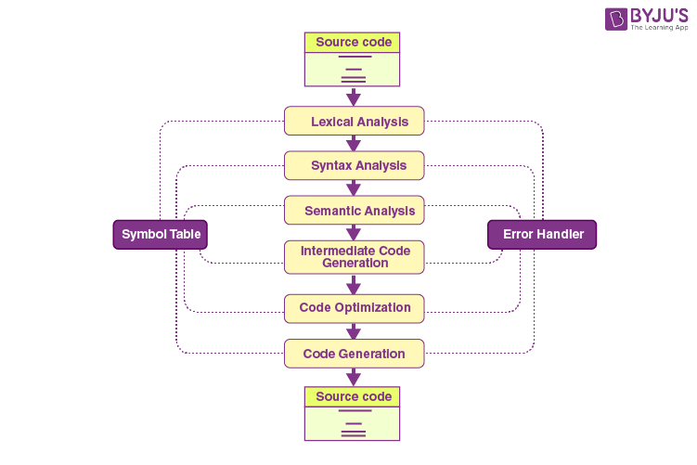
Compiler Functions

Slide 11
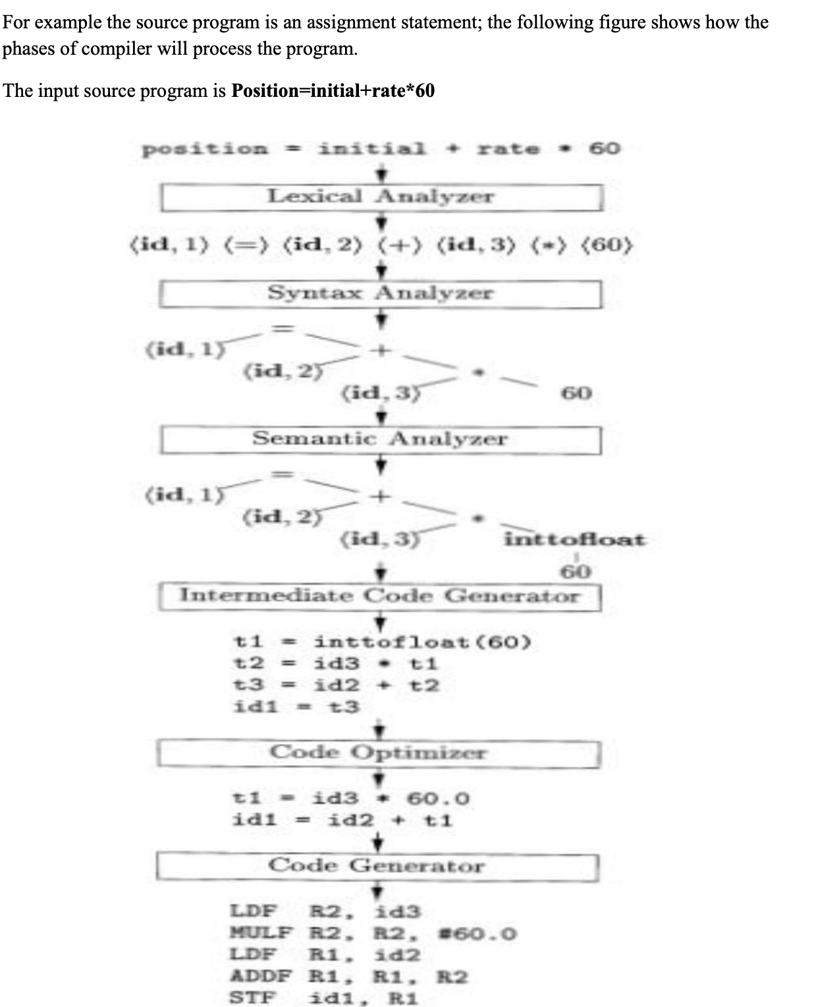

Slide 12
Lexical analysis or Lexical analyzer is the initial stage or phase of the compiler. This phase scans the source code and transforms the input program into a series of a token.
A token is basically the arrangement of characters that defines a unit of information in the source code.
NOTE: In computer science, a program that executes the process of lexical analysis is called a scanner, tokenizer, or lexer.

Slide 13
Roles and Responsibilities of Lexical Analyzer
  It is accountable for terminating the comments and white spaces from the source program.
  It helps in identifying the tokens.
  Categorization of lexical units.

Slide 14
Roles and Responsibilities of Syntax Analyzer:
Note syntax errors.
Helps in building a parse tree.
Acquire tokens from the lexical analyzer.
Scan the syntax errors, if any.

Slide 15
Grammar
In the context of compilers, grammar (specifically, Context-Free Grammar or CFG) is a formal set of rules that defines the syntactic structure of a programming language.
It acts as the "blueprint" for the language. It dictates what sequences of tokens (keywords, operators, identifiers, etc.) form valid statements, expressions, and programs.
Grammar consists of production rules (e.g., Statement → if (Expression) Statement else Statement). These rules describe how to break down complex language constructs into simpler parts.
The compiler uses these grammatical rules to check if the source code is syntactically correct (i.e., properly structured) and to guide the parsing process. If the code violates the grammar, the compiler throws a syntax error.

Slide 16
Lexical Analysis (Scanner)
This is the very first phase of the compiler. It reads the raw source code as a stream of characters (letters, digits, symbols) and groups them into meaningful sequences called tokens.
To simplify the subsequent phases by converting the raw text into a structured sequence of tokens, while ignoring irrelevant data like comments and whitespace.
The lexical analyzer (often called a scanner) removes whitespace and comments, then scans the code left-to-right. When it recognizes a pattern (e.g., a sequence of digits is a NUMBER, a reserved word like if is a keyword IF, a sequence of letters is an IDENTIFIER), it outputs a token—usually in the form of <token_type, attribute_value> (e.g., <IDENTIFIER, "total">).
It acts as the interface between the source file and the rest of the compiler, making the parsing process much more efficient by handling character-level details early.

Slide 17
As the first phase of a compiler, the main task of the lexical analyzer is to read the input characters of the source program, group them into lexemes, and produce as output tokens for each lexeme in the source program.
This stream of tokens is sent to the parser for syntax analysis.
It is common for the lexical analyzer to interact with the symbol table as well. When the lexical analyzer discovers a lexeme constituting an identifier, it needs to enter that lexeme into the symbol table. This process is shown in the following figure.

Slide 18
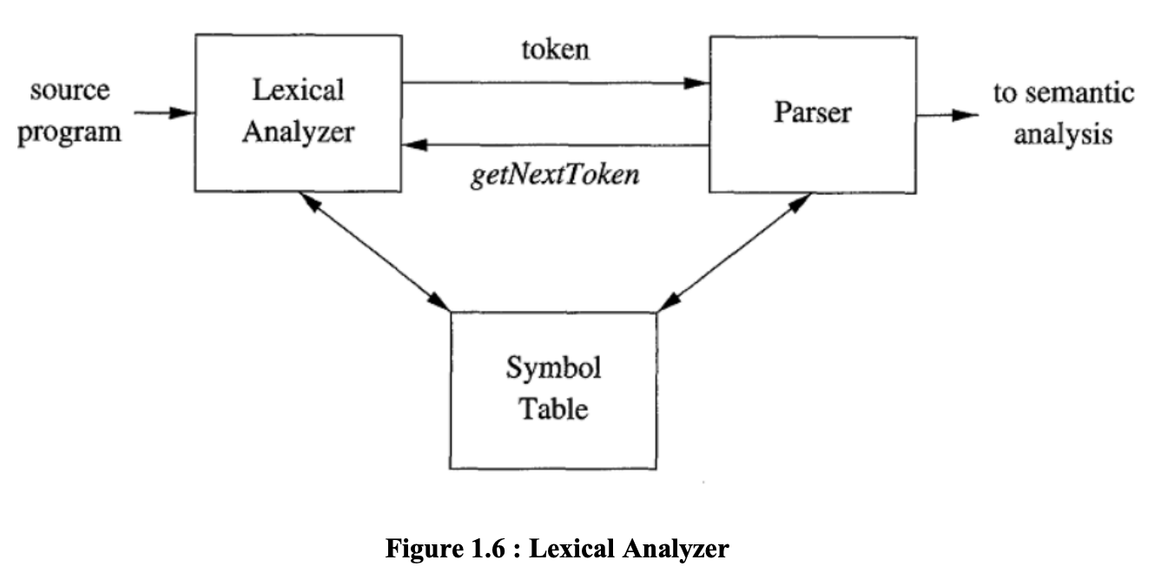

Slide 19
When lexical analyzer identifies the first token it will send it to the parser, the parser receives the token and calls the lexical analyzer to send next token by issuing the getNextToken() command.
This Process continues until the lexical analyzer identifies all the tokens. During this process the lexical analyzer will neglect or discard the white spaces and comment lines.

Slide 20
Syntax Analysis
In the compilation procedure, the Syntax analysis is the second stage.
Here the provided input string is scanned for the validation of the structure of the standard grammar.
Basically, in the second phase, it analyses the syntactical structure and inspects if the given input is correct or not in terms of programming syntax.
It accepts tokens as input and provides a parse tree as output. It is also known as parsing in a compiler.

Slide 21
In our compiler model, the parser obtains a string of tokens from the lexical analyzer, as shown in the below Figure, and verifies that the string of token names can be generated by the grammar for the source language.
We expect the parser to report any syntax errors in an intelligible fashion and to recover from commonly occurring errors to continue processing the remainder of the program.
Conceptually, for well-formed programs, the parser constructs a parse tree and passes it to the rest of the compiler for further processing.

Slide 22
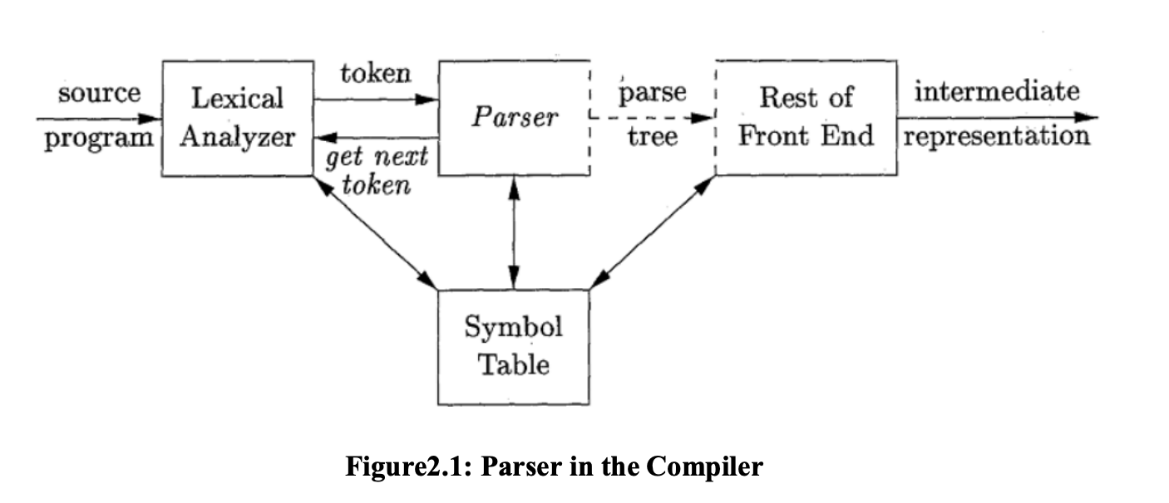

Slide 23
During the process of parsing it may encounter some error and present the error information back to the user
Syntactic errors include misplaced semicolons or extra or missing braces; that is, ―{" or "}."
As another example, in C or Java, the appearance of a case statement without an enclosing switch is a syntactic error (however, this situation is usually allowed by the parser and caught later in the processing, as the compiler attempts to generate code)

Slide 24
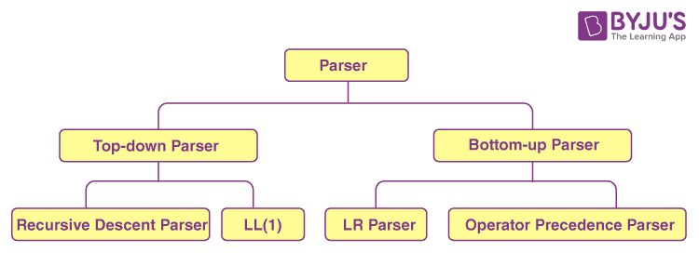
Parsing is basically classified in to following two types:
Top Down Parsing : Parse tree construction start at the root node and moves to the children nodes (i.e., top down order).
Bottom up Parsing: Parse tree construction begins from the leaf nodes and proceeds towards the root node (called the bottom up order).

Slide 25
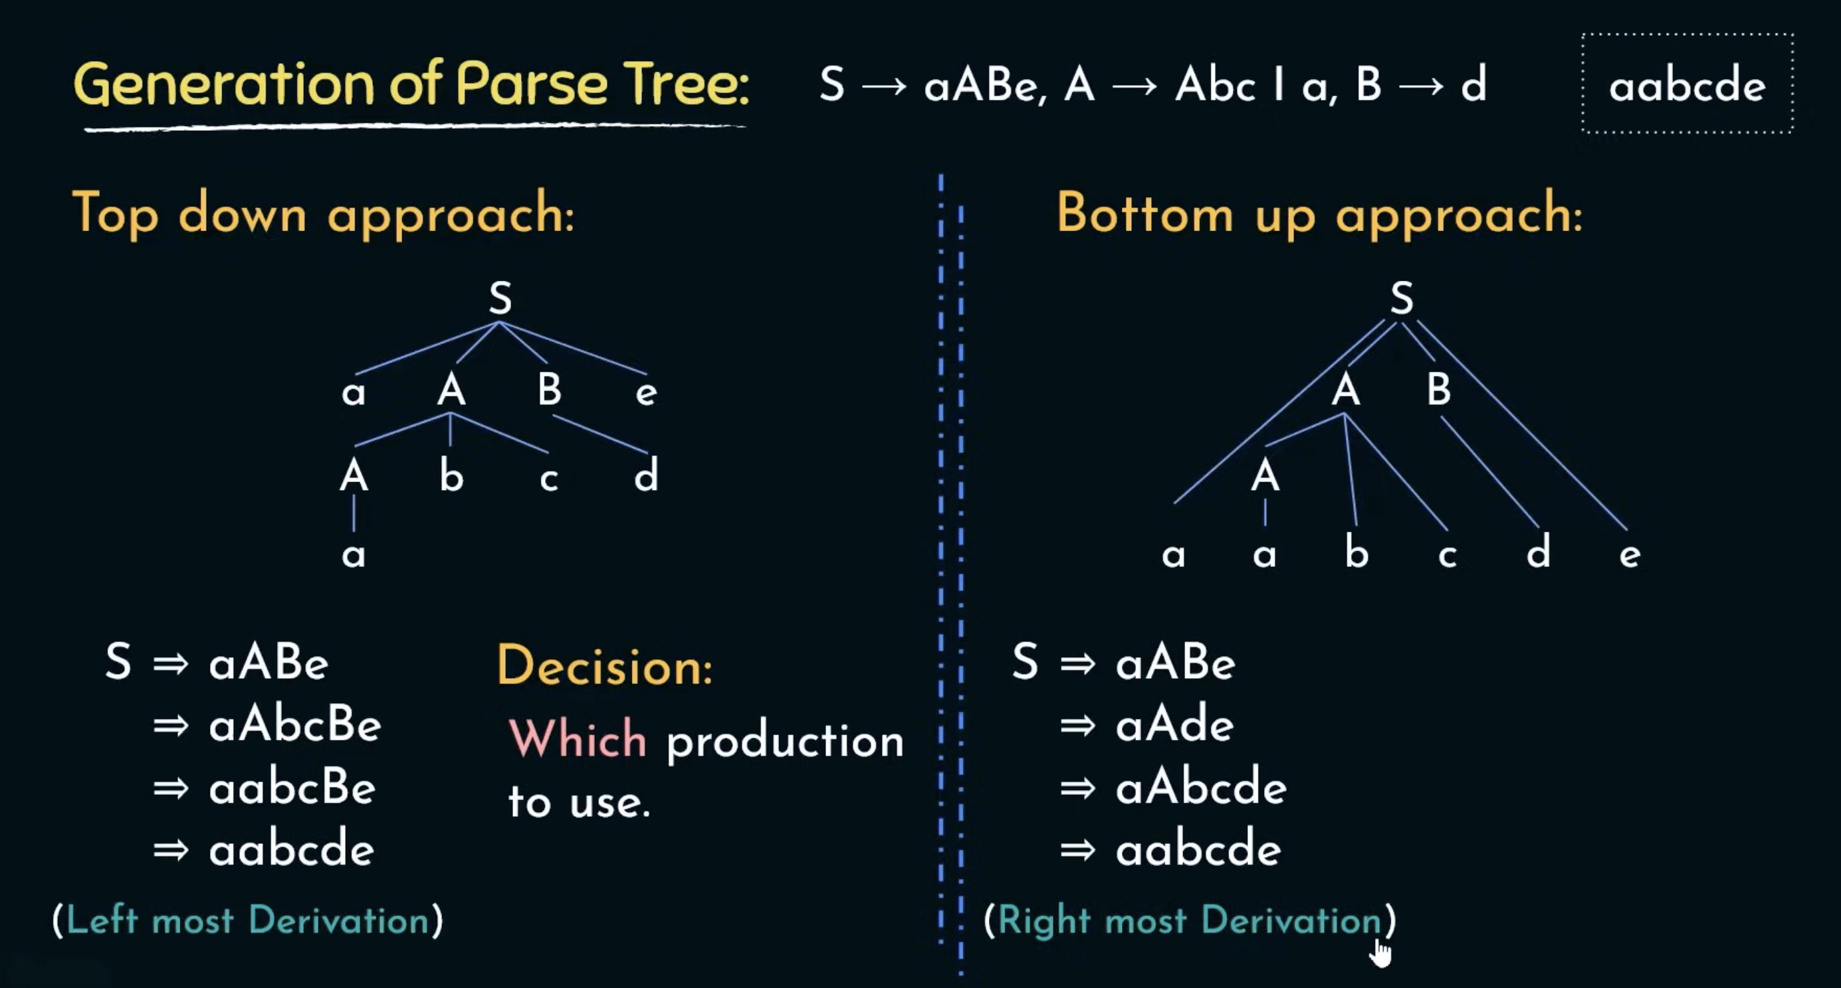

Slide 26
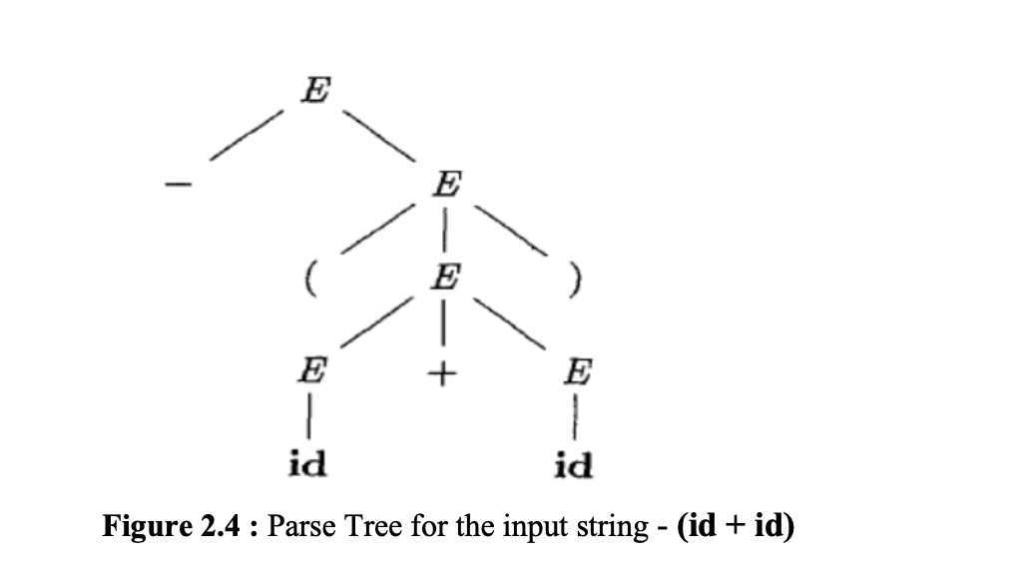
Example1:- Parse tree for the input string - (id + id) using the above Context free Grammar is

Slide 27
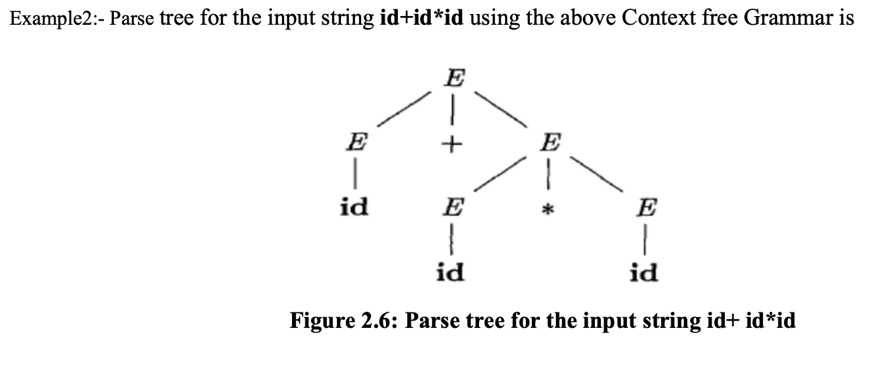

Slide 28
Recursive Descent Parsing
Use two pointers:
  iptr – points to the input symbol to be read.
  optr – points to the symbol of the output string that is initially initialized with the start symbol S.
If the symbol pointed by optr is a non-terminal, use the first production rule for expansion.
While the symbols pointed by iptr and optr match, increment both pointers.
The loop in step 3 terminates when:
a) A non-terminal appears at the output (case A).
b) The end of the input is reached (case B).
c) An unmatching terminal symbol is seen (case C).
If (case A) is true, expand the non-terminal using the first rule and go to step 9.
If (case B) is true, terminate with success.
If (case C) is true, decrement both pointers to the place of the last non-terminal expansion and use the next production rule for that non-terminal.
If there are no more productions and (case B) is not true, report an error.

Slide 29
Operator Precedence Parsing
Operator-precedence parsing is a bottom-up parsing technique that makes parsing decisions by examining pairs of consecutive operators (tokens) in the source program.
Main Idea:
  Determine which operation should be performed first by comparing precedence of adjacent operators
  Uses precedence relations to guide the parsing process

Slide 30
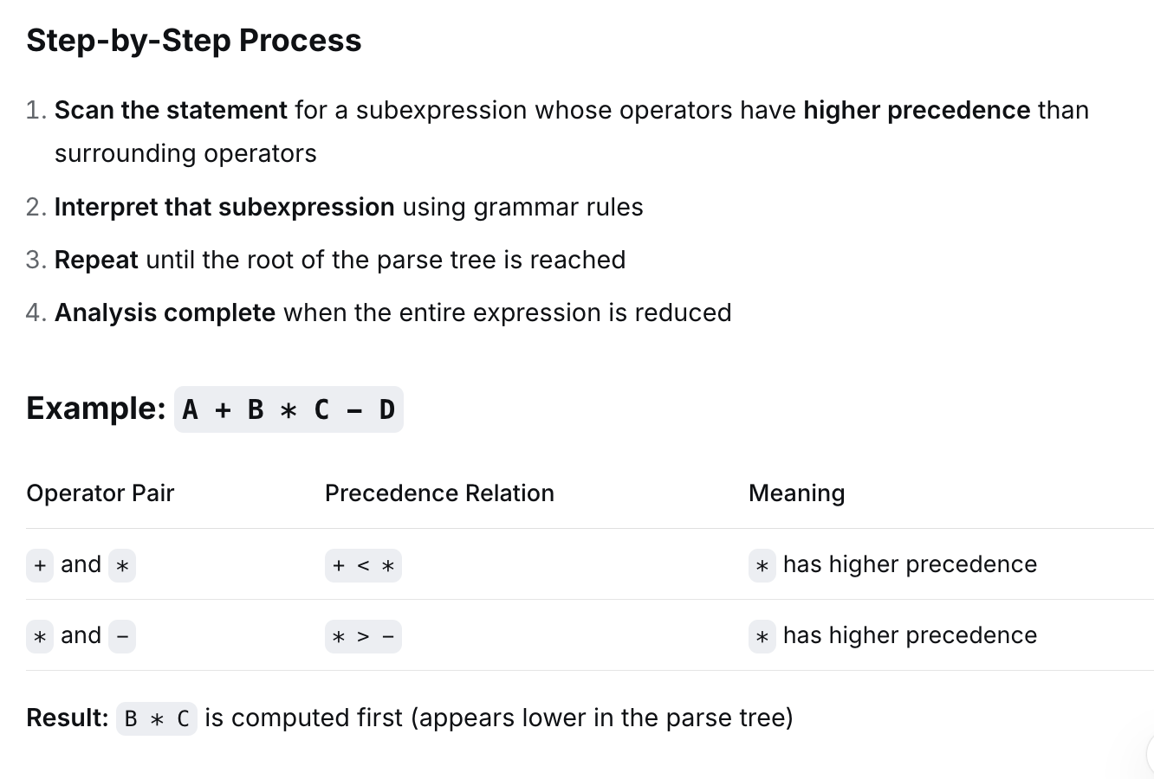

Slide 31
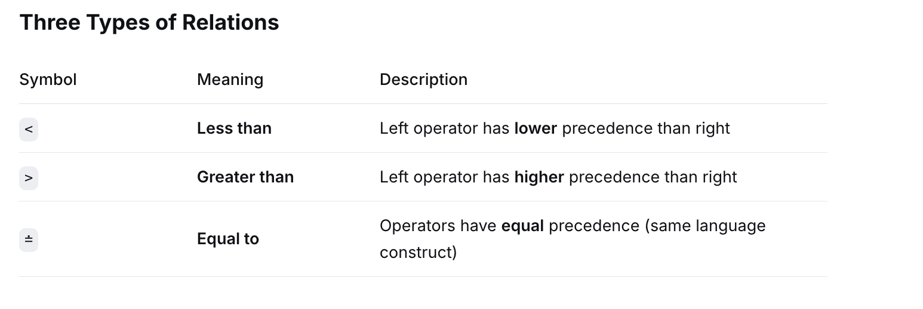

Slide 32
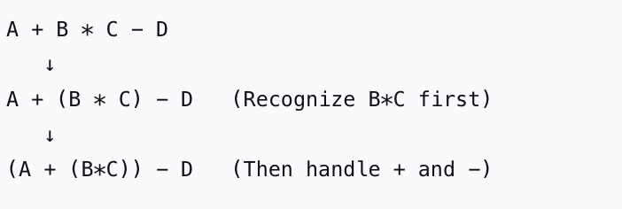
Parsing Process
Bottom-Up Approach
Start with tokens (leaves of parse tree)
Build upward by recognizing higher-precedence operations first
Reduce subexpressions according to grammar rules
Continue until the start symbol is reached

Slide 33
Advantages
Simple to implement
Efficient for expressions
No need for full grammar (only precedence relations needed)
Limitations
Works only for operator grammars (no two consecutive non-terminals)
Cannot handle ambiguous grammars
Limited to languages where operators determine structure

Slide 34
Code Generation
Code generator generates target code for a sequence of address statement
Use function getreg to assign address to variables.
Computed results are kept in registers as long as Possible which means:
  The result is needed in another computation.
  Registers are kept up to a procedure call or end of block.

Slide 35
Code Generation Algorithm:
For each statement x = y op z:
Set location L = getreg(y, z)
If y is not already in L:
  Move y to L
Generate instruction:
  op z, L
Update registers and address descriptors.

Slide 36
getreg() Algorithm
To compute getreg(y, z):
If y is stored in a register R, return R.
Else, return a new empty register if one is available.
Else, find an occupied register R, store its contents using MOV R, M, and return R.
Else, return memory (or handle as fallback).

Slide 37
